Slide 1
Aggregation
Contd…
Prof. Navneet Goyal
Computer Science Department
BITS, Pilani

Slide 2
Aggregate Navigator
How queries are directed to the appropriate aggregates?
Do end user query tools have to be “hardcoded” to take advantage of aggregates?
If DBA changed the aggregates all end user applications have to be recoded
How do we overcome this problem?
Dr. Navneet Goyal, BITS, Pilani

Slide 3
Aggregate Navigator
Aggregate Navigator (AN) is the solution
So what is an AN?
A middleware sitting between user queries and DBMS
With AN, user applications speak just base level SQL
AN uses metadata to transform base level SQL into “Aggregate Aware” SQL
Dr. Navneet Goyal, BITS, Pilani

Slide 4
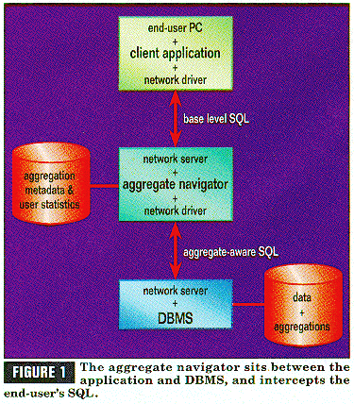
Dr. Navneet Goyal, BITS, Pilani
Figure taken from Kimball’s articles on Aggregate Navigator

Slide 5
AN Algorithm
Rank Order all the aggregate fact tables from the smallest to the largest
For the smallest FT, look in associated DTs to verify that all the dimensional attributes of the current query can be found.If found, we are through. Replace the base-level FT with the aggregate fact and aggregate DTs
If step 2 fails, find the next smallest aggregate FT and try step 2 again. If we run out of aggregate FTs, then we must use base tables
Dr. Navneet Goyal, BITS, Pilani

Slide 6
Design Requirements
#1 Aggregates must be stored in their own fact tables, separate from the base-level data. In addition, each distinct aggregation level must occupy its own unique fact table
#2 The dimension tables attached to the aggregate fact tables must, wherever possible, be shrunken versions of the dimension tables associated with the base fact table.
Dr. Navneet Goyal, BITS, Pilani

Slide 7
Design Requirements
#3 The base Fact table and all of its related aggregate Fact tables must be associated together as a "family of schemas" so that the aggregate navigator knows which tables are related to one another.
#4 Force all SQL created by any end user or application to refer exclusively to the base fact table and its associated full-size dimension tables.
Dr. Navneet Goyal, BITS, Pilani

Slide 8
Storing Aggregates
New fact and dimension table approach (Approach 1)
New Level Field approach (Approach 2)
Both require same space?
Approach 1 is recommended
Reasons?
Dr. Navneet Goyal, BITS, Pilani

Slide 9
Q & A

Slide 10
Thank You

